Slide 1
Preliminary CoVID19 Data analysis July 25, 2020 YuMei Bennett
Data Source Selection
Data Preparation
Early Data Analysis
Univariant Forecast
What’s Next

Slide 2
Data Source
Data was taken from the COVID Tracking Project, https://covidtracking.com/
The public COVID tracking project by volunteers.
The compile is taken directly from the websites of state/territory public health authorities.
Same data was chosen by JHU.
Data is up to July 15, 2020
Our goal is to provide preliminary analysis on Illinois and US COVID status and forecast
Compares the State of Illinois with National US.

Slide 3
Data Preparation
Dataset was recorded on daily basis, most recent first.
Dataset goes back to late Feb, but the early days, test was only done for sick people. Given what we know about long covid19 incubation period, a subset of the data is presented here.
Explored both daily test positive & death count, and daily positive & death rate.

Slide 4
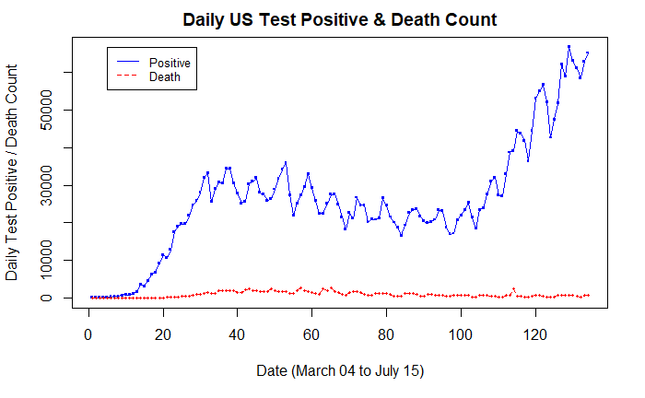
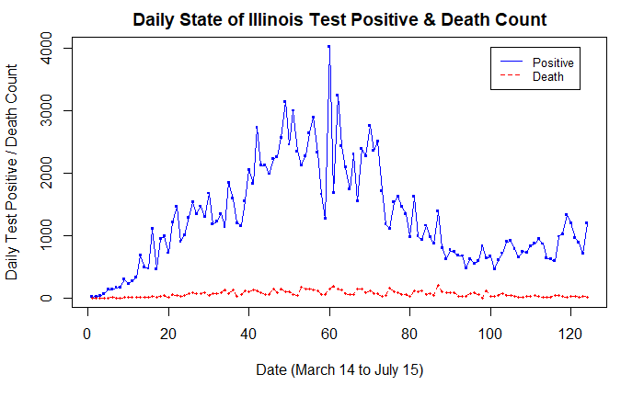
Early Data analysis – Daily Count Plot

Slide 5
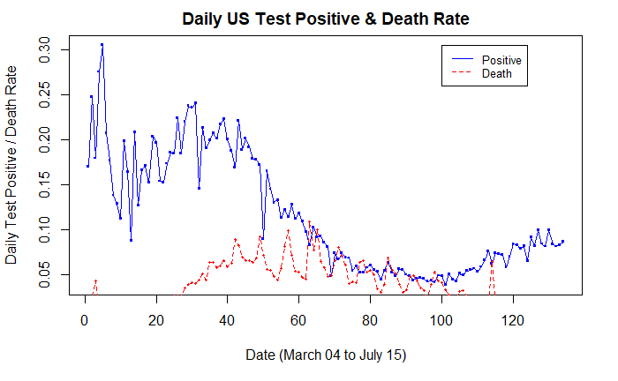
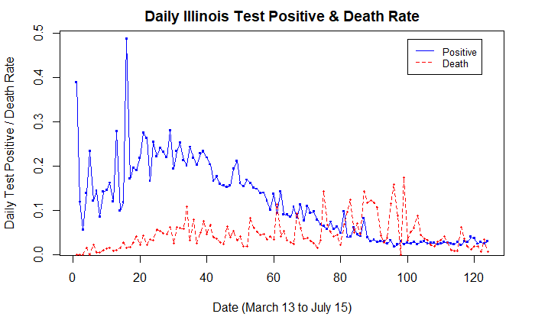
Early Data analysis – Daily Rate PLOT

Slide 6
Data Preparation – why focus on test positive rate
Percent positivity can also help us determine if an increase in cases is simply the result of expanded testing or if it signals increased transmission of the virus.
If a rise in cases count is the result of increased testing, the percent positive line could look flat or like it is decreasing over the time period when cases increased.
If a rise in cases count is the result of increased transmission, the line could appear to be increasing over that same time period.
On May 12, 2020 the World Health Organization (WHO) advised governments that before reopening, rates of positivity in testing (ie, out of all tests conducted, how many came back positive for COVID-19) of should remain at 5% or lower for at least 14 days.

Slide 7
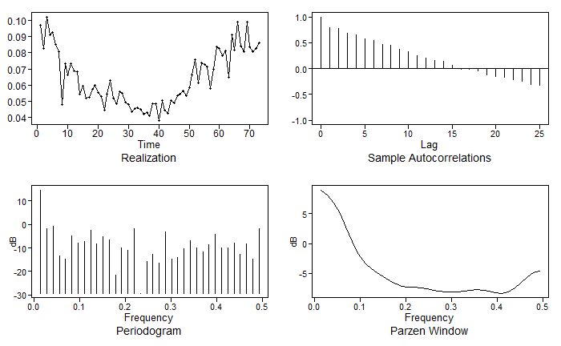
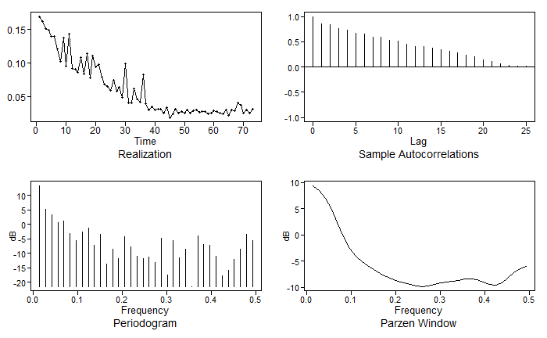
Early Data analysis – ACF and Frequency Density
US Daily Test Positive Rate – May 3rd to July 15
IL Daily Test Positive Rate – May 3rd to July 15
Both Datasets appear to be stationary. Significant high frequency near 0, with low peak at 0.5.

Slide 8
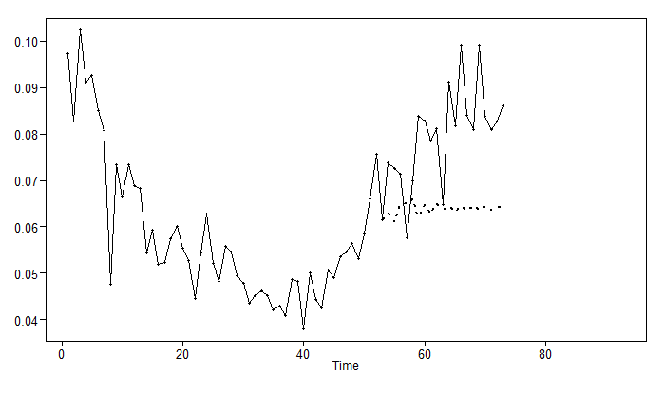
Univariant Forecast – US Long Term Model
Explored varies ARMA and ARIMA model
Tested model AIC and ASE
For long term, choose ARMA(7,2) model
ASE =0.0003084327 for last 20
Box-Ljung test pval =0.1019646

Slide 9
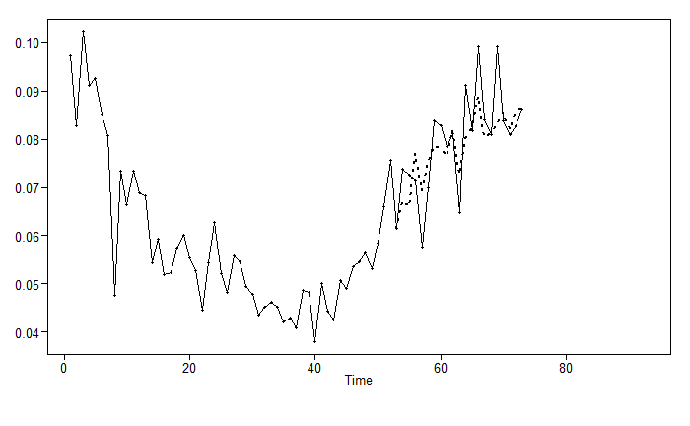
Univariant Forecast – US Short Term Model
For short term forecast, ARIMA(14,1,2) is chosen.
ASE = 0.006799229
Box-Ljung test pval 0.01949154
Although this model did not pass Box Ljung test for residual, we felt the model does best represent the short term forecast need.

Slide 10
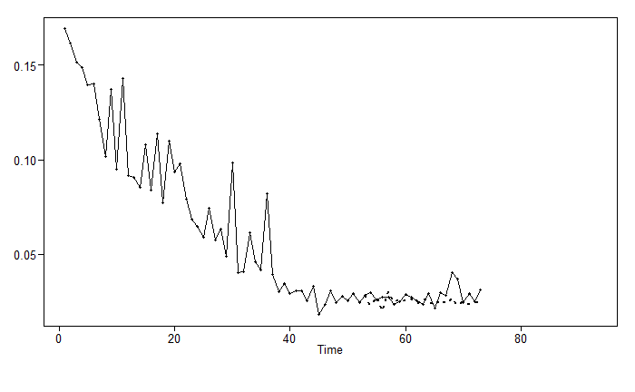
Univariant Forecast – IL Model I
ARIMA(10,2,0)
With AIC, ASE comparison, narrowed down to ARIMA (10, 2, 0) & ARMA (12,3)
ARIMA (10, 2, 0) has lower ASE of 0.003039605 vs. ARMA(12,3) 0.007807011.
ARIMA(10,2,0) did not pass Box Ljung residual white noise test.
Pval=0.0004020852

Slide 11
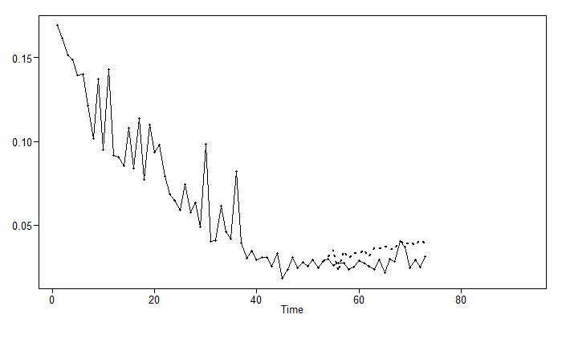
Univariant Forecast – IL Model II
ARMA (12,3)
ASE =0.007807011
Box-Ljung test pval 0.1083848
But, it is our opinion that ARIMA(10,2,0) model forecast is much more closer to reality.
Choose ARIMA(10, 2,0) model for both short term and long term forecast.

Slide 12
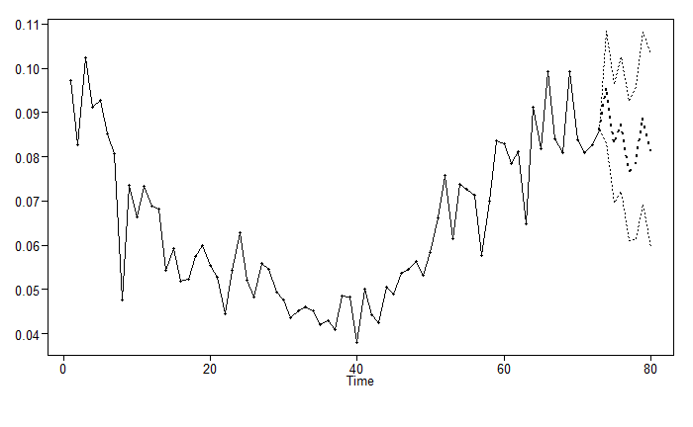
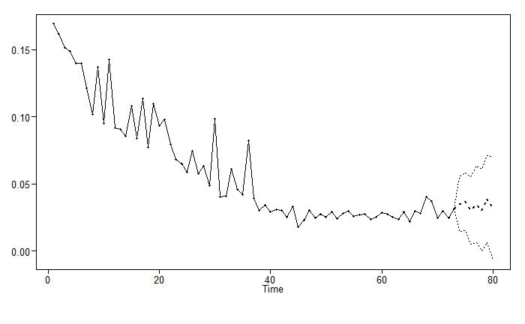
Univariant Forecast – SHORT Term forecast
US Daily Test Positive 7 days Forecast
IL Daily Test Positive 7 days Forecast

Slide 13
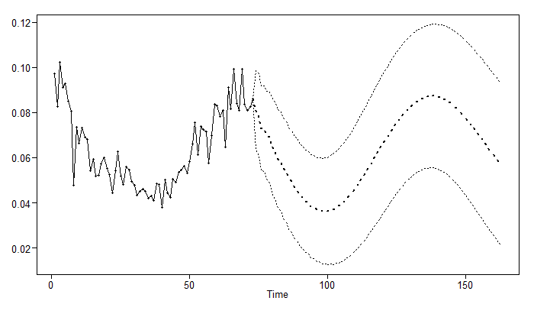
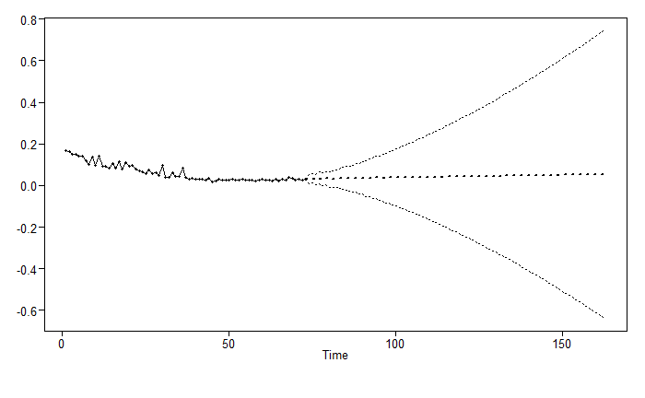
Univariant Forecast – Long Term forecast
US Daily Test Positive 90 days Forecast
IL Daily Test Positive 90 days Forecast

Slide 14
What’s Next
Continue to look for better fitting and more realistic models, this includes:
Multivariant analysis
Vector Autoregression (VAR)
Multilayer Perception (MLP)
Recurrent Neural Network (RNN)
Ensemble models
For Questions and Comments:
ybennett@smu.edu

